Slide 1
File System Files Directories

Slide 2
Review
Memory Manager
coordinate how the different types of memory are used
keep track memory to allocate and release areas of main memory to processes
manage swapping between main memory and disk
No Memory Abstractions
Single program
One OS, only one process
Special register is used to protection between OS and process
Disadvantages: slow
Multiple program
One OS, many processes locate in memory
Divided into fixed size block
Disadvantages
Internal fragmentations
Two programs both reference absolute physical memory → static relocation

Slide 3
Review
Memory Abstractions
Multiple processes locate in memory (both primary and secondary)
Base and Limit Registers
Multiple processes locate in memory and protection
Base contains the first address of process in memory
Limit contains the length of process, the process owns private address space
Disadvantages
External fragmentation (Defragment)
Slow
Swapping
Multiple processes with ready processes locate in memory and passive processes locate in HDD – swap file area
Swap out/ in operator
Disadvantages
External fragmentation
Process can not grow in memory and the swap area on the disk is full → data segment upward, stack segment downward

Slide 4
Review
Memory Abstractions
Memory Management with Bitmaps
The memory divides units with same size that has a bit corresponding bit in the bitmap (0: free, 1: occupied)
Disadvantages
Slow when searching the bitmap to find a run of k consecutive 0 bits in the map (small)
External fragment (large size)
Memory Management with Linked Lists
Maintain a linked list of allocated (P- process) and free memory (H - hole)
Allocating algorithms
First, Next, Best, Worst, Quick Fit
Virtual Memory
Software/ Process sizes larger than memory
Overlays
Developer splits program to many overlays
Disadvantages: developer‘s knowledge is important

Slide 5
Review
Memory Abstractions
Virtual Memory
Paging
Address space is broken up into pages
Physical memory is divided up into page frames
Virtual address vs. Physical address, manage address space with bit
MMU transfers Virtual address → p, d; then it looks up page table following the index to get the page frame; the page frame combines with d to determine the physical address
Page fault: the program references a part of its address space that is not in physical memory
Page table
Load to collection registers, load to memory using base register, using TLB
Excessive large page table: multilevel page, inverted page table, inverted page table with hash or TLB
Entry: Caching disabled, Referenced, Modified, Protection, Present/absent, page frame number

Slide 6
Review
Memory Abstractions
Virtual Memory
Paging - Page replace algorithms
Optimal: the page will be the latest one accessed in the future
NRU: the page has lowest class that combines R and M bit
FIFO: the page at the head of queue
Second Chance: old page has not been not referenced in the previous clock interval (R = 0). If R of page equals 1, R is reset to 0 and put the tail of the queue.
Clock (circular queue) : the page being pointed to by the hand is inspected. If R = 0, page is evicted. Otherwise, R is reset to 0, the pointer points next
LRU: the page at the end of the list is replaced, the list must be updated at each memory reference
NFU, Aging (using bit): The page with the lowest counter
Working set model, working set clock (circular queue): Third Chance with Second Chance using age > τ with bit R
Terminology: Thrashing, Locality of Reference, Demand paging, prepaging, working set, page fault rate

Slide 7
Review
Design Issues
Local vs Global Policies
Local: page frames are static allocated among current processes (thrashing or waste memory)
Global: page frames are dynamically allocated among runnable processes (thrashing to others process)
Solution
Monitor the size of working set of all processes using aging bit
The allocation is updated dynamically using PFF algorithms with To periodically determine the number of running processes, Giving each process a minimum number of frames
Load Control
Swapping and Considering not only process size and paging rate but also its characteristics
Page Size
Optimizing the size of the page and the location of page table

Slide 8
Review
Design Issues
Separate Instruction and Data Spaces
Sharing code, library, read only memory
Copy on write
Memory Mapped File
Paging the file as process
Cleaning Policy
Using two-handed clock
Front hand is controlled by the paging daemon
Back hand is used for page replacement algorithm as in the standard clock algorithm
Implementation Issues
Instruction Backup
A hidden internal is used to store the PC before each instruction is executed
A second register is used to store the registers auto-incremented or auto-decremented, and by how much
When the fault instruction is restarted, the OS can unambiguously undo all the effects of it

Slide 9
Review
Implementation Issues
Locking Pages in Memory
Lock pages engaged in I/O in memory so that they will not be removed
Do all I/O to kernel buffers & copy the data to use pages later
Backing Store
Associated with each process is the disk address of its swap area, that is where on the swap partition its image is kept (that also kept in process table)
Paging to a static swap area vs. Backing up pages dynamically
Segmentation
Is a logical entity and Consists of a linear sequence addresses, from 0 to some maximum that can grow and shrink independently without effecting each other
To specify an address in the segmented memory, the <segment-number, offset> is used
Implementing
Segment table
Segmentation with Paging

Slide 10
Objectives
Files
File Naming
File Structure
File Types
File Access
File Attributes
File Operations
An Example Program using File System Calls
Directories
Single-Level Directories Systems
Hierarchical Directory Systems
Path Names
Directory Operations

Slide 11
Overview
Problems
While a process is running, it can store a limited amount of information within its own address space. However, the storage capacity is restricted to the size of the virtual address space
The information is lost when the process terminates
It is frequently necessary for multiple processes to access (parts of) the information at the same time
There are 3 essential requirements for long-term information storage
It must be possible to store a very large amount of information
The information must be survive the termination of process using it
Multiple processes must be able to access the information concurrently
Disk and its 2 operation (read, write) are used to solve the long-term storage problem

Slide 12
Files
Definition
Are the abstraction (objects and mechanism), that models in a convenient way the information stored and read it back on hardware devices and are managed by OS
Are logical units of information (created by processes)
Processes can read existing files & create new ones if need be
Information stored in files must be persistent (not be affected by process creation and termination)
File system
The OS’s component that manages the information stored on the storage devices and provides the users access to that information in a convenient way
Hides the complexity of storage hardware devices
Provides the users a uniform logical view of the information stored on these devices, based on the concept of file
Maps files onto physical devices

Slide 13
Files
Naming
When a process creates a file, it gives the file a name.
When the process terminates, the file continues to exist and can be accessed by other process using its name
File name = string of characters
The exact rules for file naming vary somewhat from system to system
Distinction between upper and lower letters
Limit of name length
Extension (optional)
Provides some information about the file’s content structure
Is used to register with OS and specify for each program owns that extension
Ex: hello.c; hello.bat, hello.txt

Slide 14
Files
Structure
There are 3 common way possibilities
An unstructured sequence of bytes
Byte sequences (maximum flexibility)
Can put any thing they want and name file any way
Record sequence
A file is a sequence of fixed length record, each with some internal structure
Provides read, write, and append operation
Tree
A file consists of a tree of records, not necessarily all the same length, each containing a key field in a fixed position in the record
The tree is sorted on the key field, to allow rapid searching for a particular key
Provides the get operation to get the record with specifies key
OS decides the new record’s position

Slide 15
Files
Structure
Tanenbaum, Fig. 4-2.

Slide 16
Files
Types
OS supports several types of files
Regular files
Contain user data information (ASCII or binary)
Directories
System files for maintaining the structure of the file system
Character Special files
Are related of I/O ad used to model serial I/O devices
Ex: terminals, printer, networks
Block Special files
Disks Model

Slide 17
Files
Access
Sequential access
Reads the bytes or records in order, starting at the beginning, but could not skip around and read them out of order
Could be rewound
Specific to magnetic tapes
Operation: read
Random access
Reads the bytes or records out of order, or to access records by key rather than by position
Specific to disks
Operation: seek

Slide 18
Files
Attributes
The extra information is associated to file by OS
Is also called metadata
Some attributes
Type
Length
Time stamps
creation time, time of last access, time of last modification
Owner
Access rights
read (view), write (modify), execute, delete
Different flags
hidden, system, locked etc.
…..

Slide 19
Files
Operations
Create
Delete
Open
Close
Read
Write
Seek
Get attributes
Set attributes
Rename

Slide 20
Files
An Example Program Using System Calls
Tanenbaum, Fig. 4-5.

Slide 21
Files
An Example Program Using System Calls
Tanenbaum, Fig. 4-5.

Slide 22
Directories Definition
A way of organizing files
Impose a hierarchy of files
Consists of a collection of files and subdirectories
Can be viewed as a special file managed by the OS

Slide 23
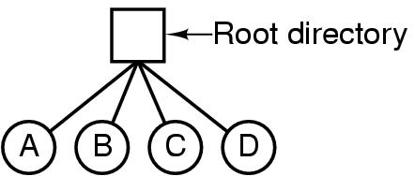
Directories/ Folders
Single-Level Directory Systems
Is having one directory containing all files (root directory)
Applying on system that can be used by only one or many users
Is adequate for simple dedicated applications
Advantages
Simplicity
The ability to locate file quickly
Disadvantages
The file name can be duplicated in one/ many users
Tanenbaum, Fig. 4-6.

Slide 24
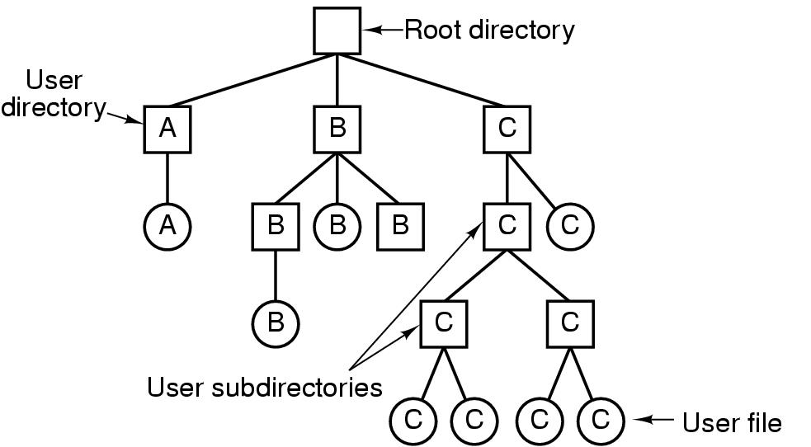
Directories/ Folders Hierarchical Directory Systems
Single-Level
Hierarchical
It would be impossible to find anything if all files were in a single directory (slow) → group related files together
There can be as many directories as are needed group the files in natural ways
If multiple users share a common file server, as is the case many computer networks, each user can have a private root directory for his or her own hierarchy
The ability for users to create an arbitrary number of subdirectories provides a powerful structuring tool for users to organize their work
Tanenbaum, Fig. 4-7.

Slide 25
Directories/ Folders Path Names
Absolute path name
Starts from the root directory to the file
Ex
/home/students/john/program.c (in Linux)
C:\Program Files\Application\run.exe (in Windows)
Relative path name
Starts from the current (working) directory that can be owned to users
Each application has its own working directory
Ex
john/program.c (in Linux)
application\run.exe (in Windows)
Special directories in relative paths
current directory: .
parent directory: ..

Slide 26
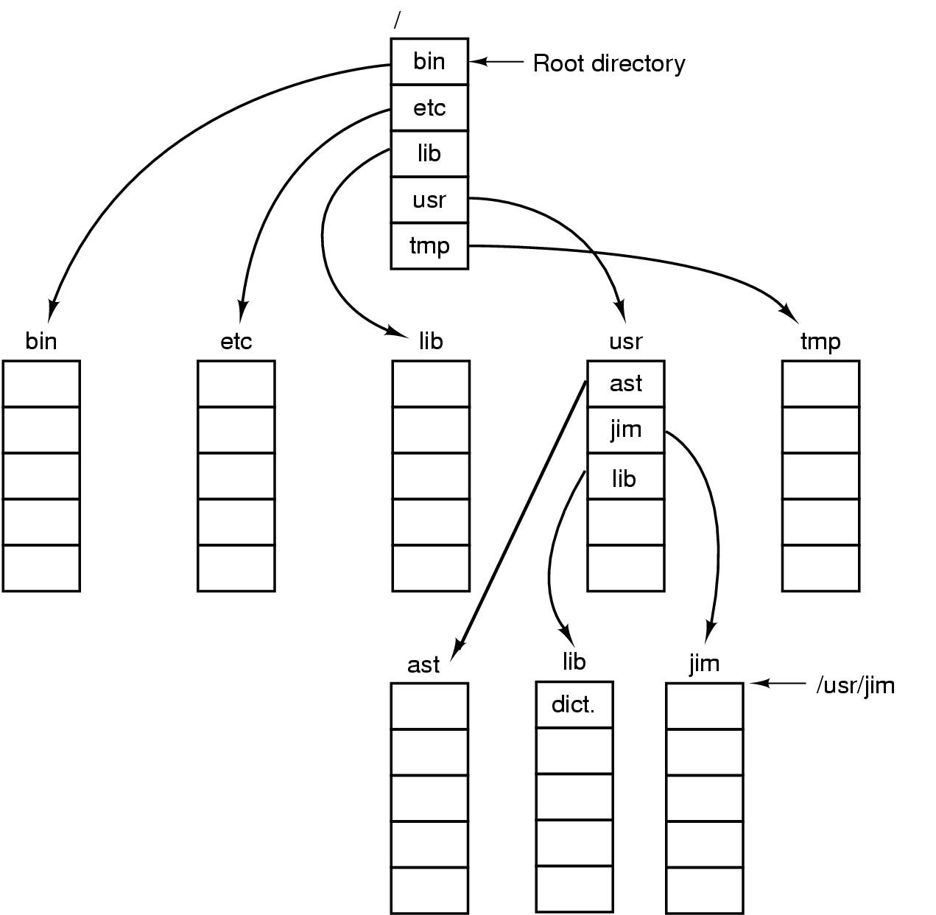
Directories/ Folders Path Names
Tanenbaum, Fig. 4-8.

Slide 27
Directories/ Folders Operations
Create
Delete
Opendir
Closedir
Readdir
Rename
Link: Allow a file to appear in more than one directory
Unlink

Slide 28
File System File System Implementation

Slide 29
Review
File System
Manages the information stored and hides the complexity on the storage devices
Provides the users access information in a convenient way and a uniform logical view
File
Abstraction, Object and Mechanism
Name, Path (absolute vs. relative), Structure, Type, Access, Attributes, Operations
Directory (Single level vs. Hierarchy)
Block & Characteristic special File

Slide 30
Objectives…
File System Implementation
File System Layout
Implementing Files
Implementing Directories
Shared Files
Log-Structured File Systems
Journaling File Systems
Virtual File Systems

Slide 31
File System Implementation
How files and directories are stored
How disk space is managed
How to make everything work efficiently and reliably

Slide 32
File System Implementation File System Layout
File Systems
Are stored on disks
Disks can be divided up into one or more partitions, with independent file systems on each partition
The 1st block in each partition is called boot block that exists even if the partition does not contain a bootable OS
The 2nd block is the super block
Contains the all key parameters about the file system including magic number (file system type), the number of blocks in the file system, and the other key administrative information
Is read into memory when the computer is booted or the file system is first touched
Next block is free blocks (ex: form of bitmap or a list of pointer)
The following block are i-nodes, an array data structures, one per file, telling all about the file
After that might come the root directory, which contains the top of the file system tree
Finally, the remainder contains all the other directories and files

Slide 33
File System Implementation File System Layout
File Systems (cont)
Sector 0 of the disk is called the Master Boot Record (MBR) that is used to boot the computer.
The end of the MBR contains the partition table
Gives the starting and ending addresses of each partition
One of the partitions in the table is marked as active
Mechanism of booted computer
The computer is booted, the BIOS reads in and executes the MBR
MBR locates the active partition, reads in its boot block and executes it
The program in boot block loads the OS contained in that partition

Slide 34
File System Implementation File System Layout
Tanenbaum, Fig. 4-9.

Slide 35
File System Implementation Implementing Files
Contiguous Allocation
Store each file as a contiguous run of disk blocks
Advantages
Simple to implement
Keeping track of files’ blocks needs
disk address of first block
the number of allocated blocks
High performance: get entire file from disk in one operation (only seek to first block)
Disadvantages
Fragmentation (internal and external)
Difficult to increase the file’s size

Slide 36
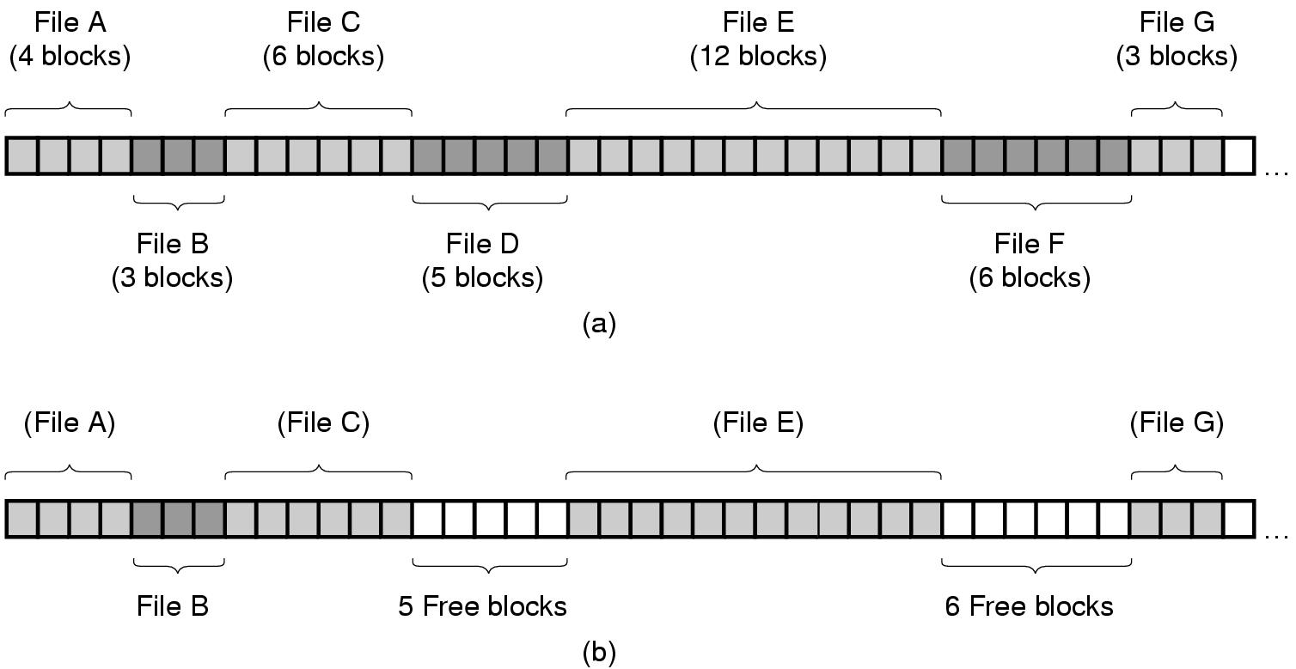
File System Implementation Implementing Files
Tanenbaum, Fig. 4-10.

Slide 37
File System Implementation Implementing Files
Linked List Allocation
Storing files is to keep each one as a linked list of disk blocks
First word of each block is used as pointer to the next one and the rest of the block is for data
Advantages
No external fragmentation (still internal fragmentation)
It is sufficient for the directory entry to merely store the disk address of the first block
Disadvantages
Random access is extremely slow
The amount of data storage in a block is not a power of two because the pointer takes up a few bytes

Slide 38
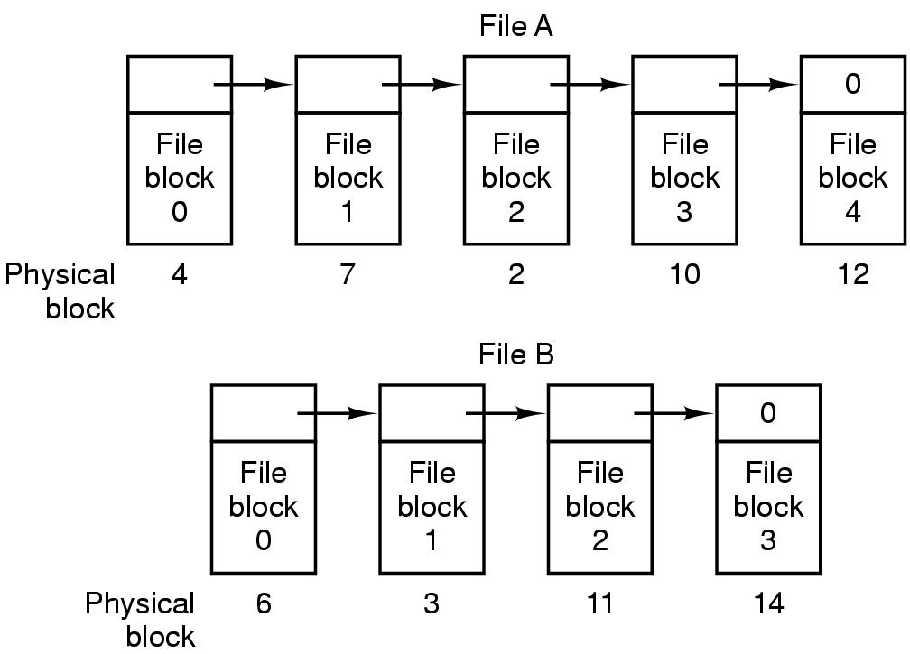
File System Implementation Implementing Files
Tanenbaum, Fig. 4-11.

Slide 39
File System Implementation Implementing Files
Linked List Allocation using a Table in Memory
Both the disadvantages of the linked list allocation can be eliminated by taking the pointer word from each disk block and putting it in a table in memory
(File Allocation Table – FAT)
Advantages
The same advantages as linked list allocation
The entire block is available for data
Random access is relatively fast
Disadvantages
The entire table must be kept for efficiency in memory
Ex: for a 200GB HDD, 1KB Block-size, 4 bytes for an entry → 200 mil. entries → 600MB – 800MB of memory for FAT
Not wildly practical and does not scale well to large disks

Slide 40
File System Implementation Implementing Files
Tanenbaum, Fig. 4-12.

Slide 41
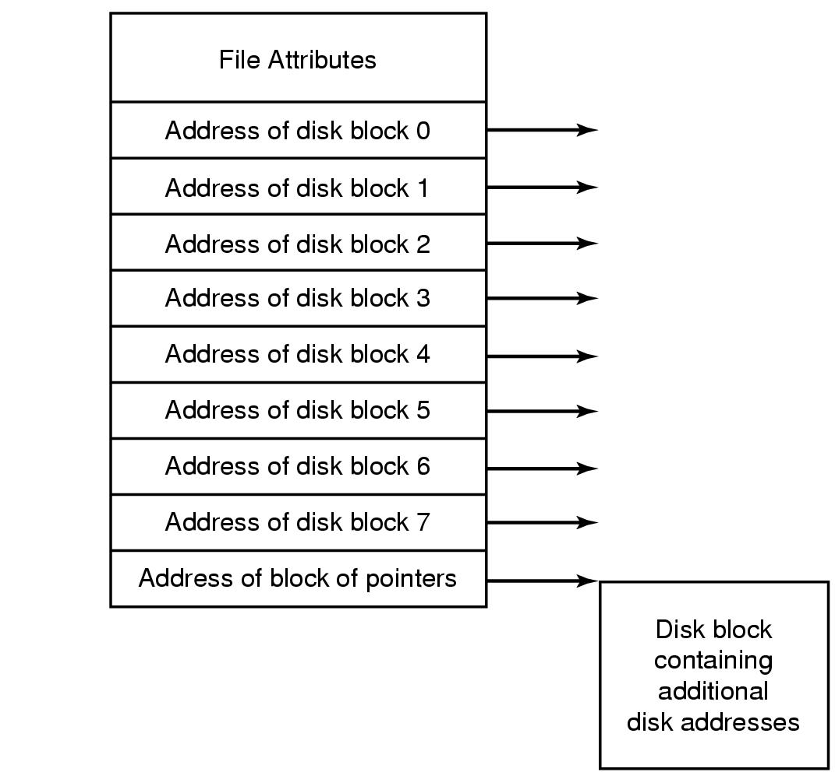
File System Implementation i-nodes
Is briefcase of index-nodes
A data structure (involve 2 parts) associates with every file
Part 1: Lists the attributes
Part 2: Disk addresses of the file’s block. It divides 2 sub parts
Sub part 1: contain the address of disk block i^{th} in directly
Sub part 2: contain the address of block of pointers that is used with large file (multilevel index)
Given the i-node, it is then possible to find all the blocks of the file
Tanenbaum, Fig. 4-13.

Slide 42
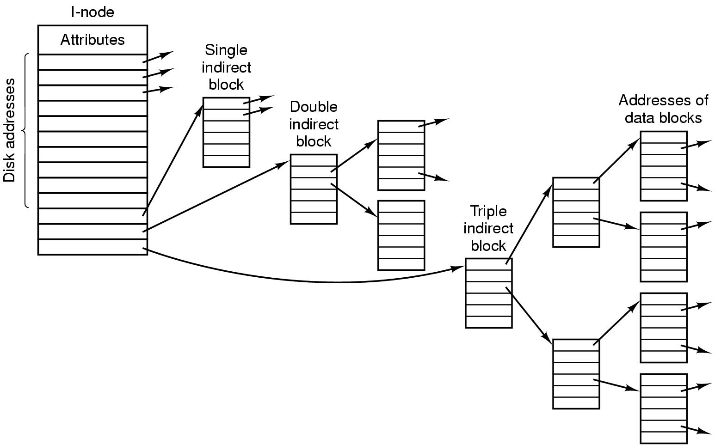
File System Implementation i-nodes – Example

Slide 43
File System Implementation i-nodes
Advantages
The space is reserved because i-node need only be in memory when the corresponding file is open
Allows the maximum number files that may be opened at once
Is smaller than the space occupied by the file table
Disadvantages
Each i-nodes has room for a fixed number of disk addresses (not flexibility) → reserve the last disk not for data block, but it is used to contains more disk block address
Ex: An i-nodes has contain 10 direct addresses and 1 single indirected addresses of 4 bytes each and all disk blocks are 1KB. What is the largest possible file?
10 direct address with 1KB each block: 10 * 1KB = 10KB
1 single indirected address
Size 1KB = 1024 byte
The pointer is 4 byte → 1024/4 = 256 pointer can point 256 block address with 1K
→ 256 * 1KB = 256KB
→ The largest possible file is 10 + 256 = 266 KB

Slide 44
File System Implementation Implementing Directories
The main function of the directory system is to map the ASCII name of a file onto the information needed to locate the data of that file
When a file is opened, the OS used the path name to locate the directory entry that contains
The information needed to find the disk blocked such as disk address of entire file, or the number of the first block, or the number of the i-node
Some file attributes
In simple design, a directory consists of
A list of fixed size entries, one per file, containing a (fixed-length) file name, structure of the file attributes, and one or more disk addresses
Or just a file name and i-node number

Slide 45
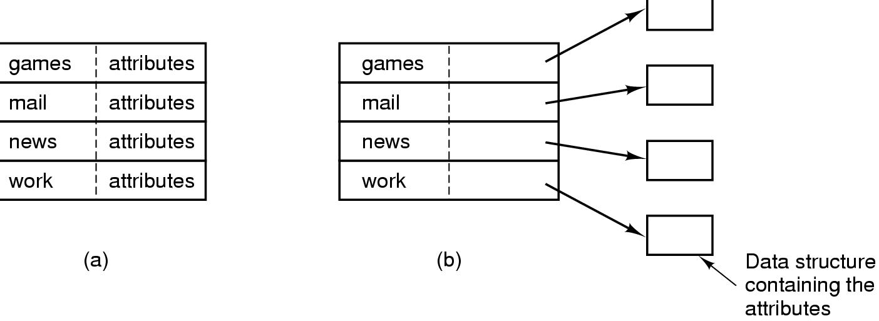
File System Implementation Implementing Directories
Tanenbaum, Fig. 4-14.

Slide 46
File System Implementation Implementing Directories
Long and variable-length file name
First approach (simplest)
Set a limit on file name length, typically 255 characters
Disadvantages: wastes a great deal of directory space
Second approach: All directories entries are same size contains
Starting with the length of the entry
Following with the file attributes
Lasting is actual file name with long it may be (each file name is terminated by special character)
To allow each directory entry begin on word boundary, each file name is filled out to an integral number of words
Disadvantages
When a file is removed, a variable-sized gap is introduced into the directory into which the next file to be entered may not fit → fragmentation
A single directory entry may span multiple pages → page fault occurs when reading a file name

Slide 47
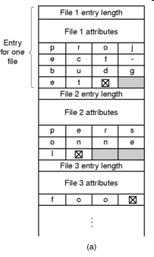
File System Implementation Implementing Directories
Tanenbaum, Fig. 4-15.

Slide 48
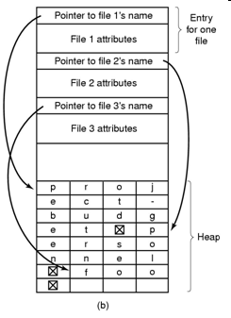
File System Implementation Implementing Directories
Long and variable-length file name (cont)
Third approach (Improvement)
Making the directory entries themselves all fixed length and keep the file names together in a heap at the end of the directory
Advantages
When an entry is removed, the next file entered will always fit there
No filler character after the file name
Tanenbaum, Fig. 4-15.

Slide 49
File System Implementation Implementing Directories
Searching Directories
Search linearly from beginning to end when a file name has to be looked up → slow with extreme long directories
To speed up, the hash table is used
Advantage: faster lookup
Disadvantages: more complex administrator
Applying to the large directories, the searching result is cached
Before starting a search, a check is first made in the cache
If so, it can be located immediately
Otherwise, the searching is started

Slide 50
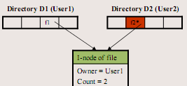
File System Implementation Shared Files
Sharing file is useful in working together on a project
A shared file appear simultaneously in different directories belonging to different users
Problems
The changing of the shared file is listed in the directory of user doing the executing (not visible to other users)
The first solution (traditional/ hard linking)
Disk blocks are not listed in directories, but in a little data structure (i-node) associated with the file itself. The directories would then point just to the little data structure
Advantages
One i-node
No new blocks allocated
Disadvantages:
Can introduce inconsistency
A user can be billed for a “removed file”

Slide 51
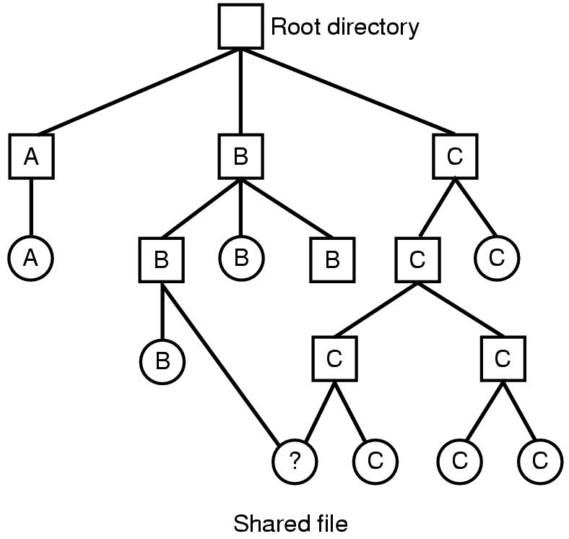
File System Implementation Shared Files
Directed Acyclic Graph - DAG
Tanenbaum, Fig. 4-16.

Slide 52
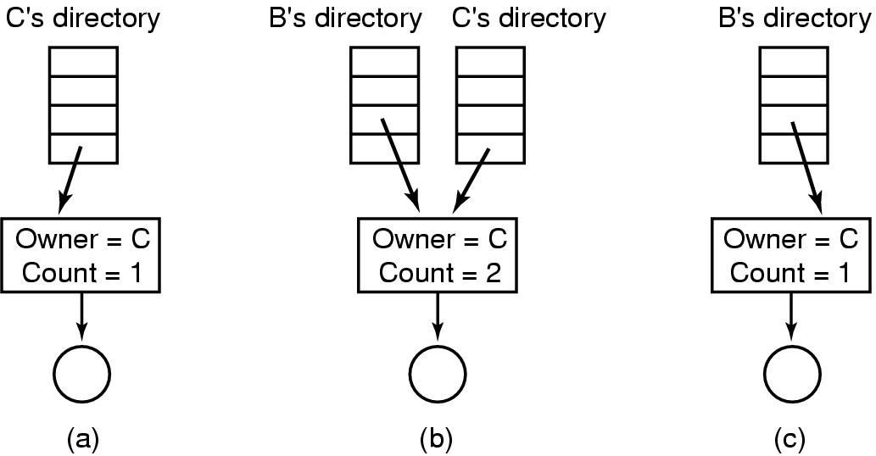
File System Implementation Shared Files
Traditional/ Hard Linking
Tanenbaum, Fig. 4-17.

Slide 53
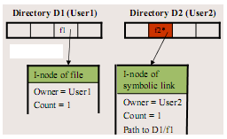
File System Implementation Shared Files
Second solution (symbolic linking)
By having the system create a new file (contains only path name), of type LINK, and entering that file in B’s directory.
When B reads from the linked file, the OS looks up name of the file, and read that file
Advantages:
No inconsistency
Can be used to link to files in a network (only using path name)
Disadvantages:
Extra overhead for getting the file i-node
Extra i-node needed for each symbolic link
Problems
When links are allowed, files can have
two or more paths → execute one more actions

Slide 54
File System Implementation Log-Structured File Systems (LFS)
Problem
In most file system, writes are done is very small chunks (highly inefficient)
In UNIX
To write new file, the i-node for the directory, the directory block, the i-node for the file, and the file itself must all be written
If a crash occurs before the write done, the file system exposes serious consistency problems. Thus, all the writing task can be delayed

Slide 55
File System Implementation Log-Structured File Systems (LFS)
Solutions: using LFS
Structure the entire disk as a log
All writes are initially buffered in memory, and periodically, all the buffered writes to the disk in a single segment at the end of the log
A single segment
Contains i-nodes, directory blocks, and data blocks, all mixed together
At the start of each segment is a segment summary telling what can be found
i-nodes are scattered all over the log (the blocks are located in the usual way when an i-node is located)
Finding i-node is much harder, since its address cannot simply calculated from its i-number.
Thus, an i-node map, indexed by i-number is maintained
Entry i in this map points to i-node i on the disk
The map is kept on disk, but it is also cached → the most heavily used parts will be in memory most of the time
Opening a file consists of using the map to locate the i-node for file. Once the i-node has been located, the addresses of the blocks can be found from it. All of the blocks will themselves be in segments somewhere in the log

Slide 56
File System Implementation Log-Structured File Systems (LFS)
Cache - Buffer
Start Disk
Last Data stored

Slide 57
File System Implementation Log-Structured File Systems (LFS)
Cache - Buffer
Start Disk
Log
Last Data stored

Slide 58
File System Implementation Log-Structured File Systems (LFS)
Cache - Buffer
Start Disk
Log
Last Data stored

Slide 59
File System Implementation Log-Structured File Systems (LFS)
Cache - Buffer
Start Disk
Log
Last Data stored

Slide 60
File System Implementation Log-Structured File Systems (LFS)
Cache - Buffer
Start Disk
Problems
Log
Last Data stored

Slide 61
File System Implementation Log-Structured File Systems (LFS)
Problems
Disks are finitely large, thus when the log occupies the entire disk, no new segments can be written
Many existing segments may have blocks that are no longer need but they still occupy space is previously written segments
Solutions
Cleaner thread spends its time scanning the log circularly to compact it
It starts out by reading the summary of first segment in the log to see which i-nodes and files are there
It then checks the current i-node map to see if the i-nodes are still current and file blocks are still in use → is written in the next segment. Otherwise, that information is discarded
Cleaner moves along the log, removing old segments from the back and putting any live data into memory for rewriting in the next segment
→ the disk is a big circular buffer, with the writer thread adding new segment to the front and the cleaner thread removing old ones from the back
→ complexity (it is a theory)

Slide 62
File System Implementation Journaling File System
Keep a log of what the file system is going to do before it does it
If the system crashes before it can do its planned work
Upon rebooting the system can look in the log to see that was going on at the time of the crash and finish the job
NTFS and Linux ext3 file system applied
Operations required to remove a file in UNIX:
Remove the file from its directory.
Release the i-node to the pool of free i-nodes.
Return all the disk blocks to the pool of free disk blocks.
Problems
The first step is completed and the system crashes
The i-node and file blocks will not be accessible from any file, but will also not be available for reassignment
The second step is completed and the system crashes
Only blocks are lost
If the order of operation is changed
If the i-node is released first, then after rebooting, the i-node may be reassigned, but the old directory entry will continue to point to it, hence to the wrong file
If the blocks are released first, then a crash before i-node is cleared (means the valid directory entry points to an i-node listing blocks now is the free storage pool)

Slide 63
File System Implementation Journaling File System
JFS
First, write a log entry listing the three actions to be completed
Then, the log entry is written to disk
Only after the log entry has been written, do the various operations begin
After complete successfully, the log entry is erased
Therefore, if the system now crashed, upon recovery the file system can check the log to see if any operation were pending → all of them can be rerun until the file is correctly removed
Requirements
The logged operations must be idempotent (they can be repeated as often as necessary without harm)
The crash recovery can be made and secure
Practically, JFS is applied to DB concept with atomic transaction

Slide 64
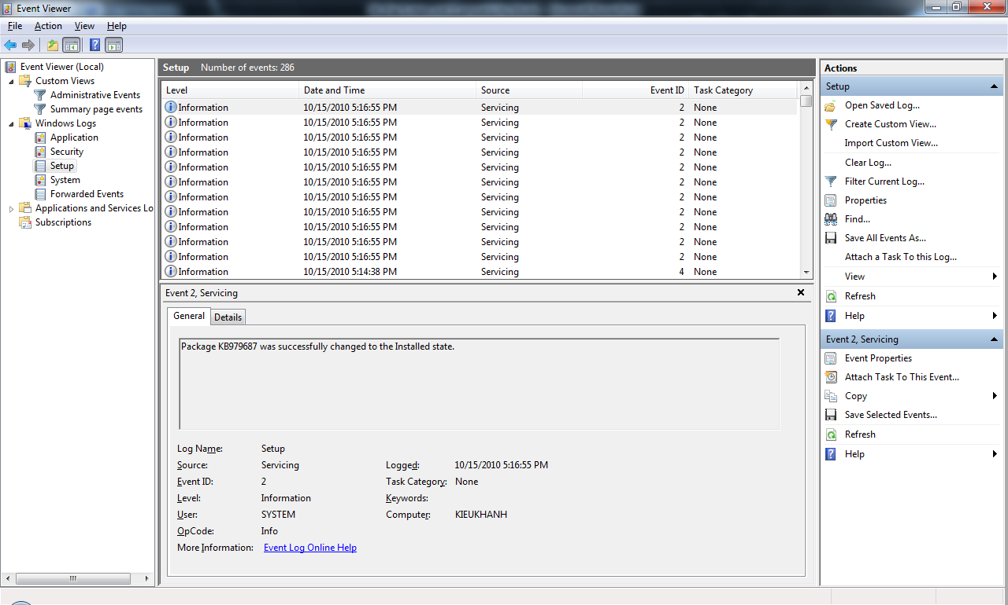
File System Implementation Journaling File System – Example

Slide 65
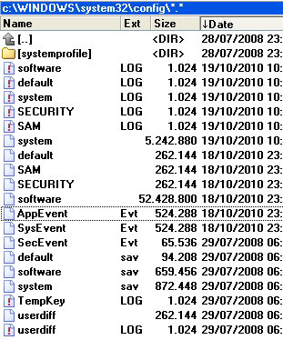
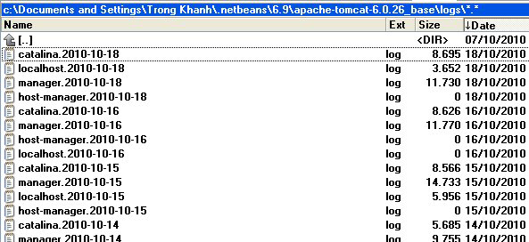
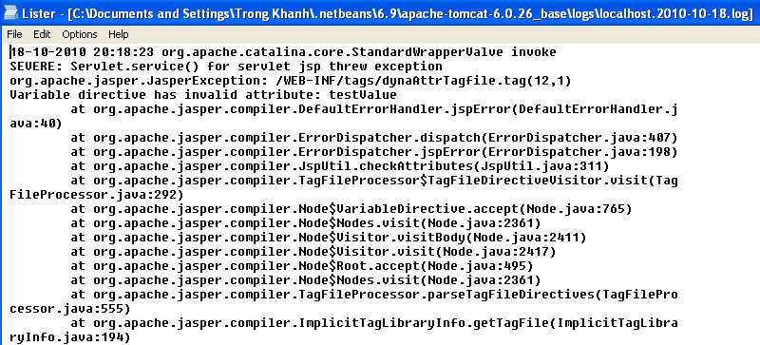
File System Implementation Journaling File System – Example

Slide 66
File System Implementation Virtual File Systems
Problems
Many different file systems are used on the same computer, even same OS
Ex: Windows Vista, XP used NTFS, FAT32, FAT 16
Solution is Virtual File System (Kleiman, 1986 – Sun Microsystems)
Try to integrate multiple file systems into an orderly structure
The key idea is to abstract out that
Part of file system is common to all file system
Put that code in a separate layer that calls the underlying concrete file systems to actual manage the data
The VFS is a upper interface to user processes and the lower interface to concrete file system
All system calls (coming from user processes) relating to files are directed to the VFS for initial processing
Does not know or care where the data are stored or what the underlying file system is like
Is implemented essentially object oriented
Supports key object types as super block, v-node, directory, mount table, an array of file descriptors

Slide 67
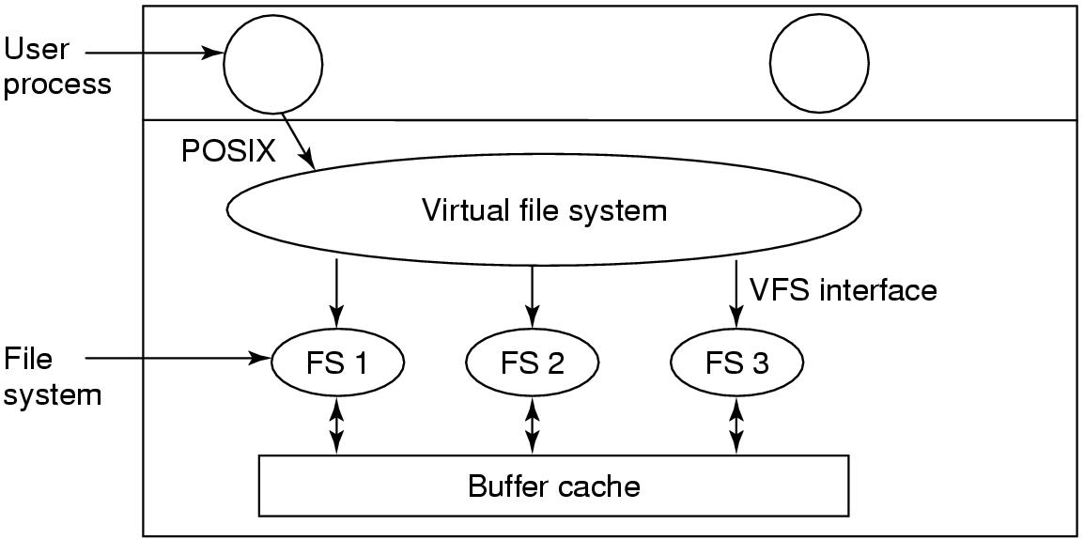
File System Implementation Virtual File Systems
Tanenbaum, Fig. 4-19.

Slide 68
Summary
File System Implementation
Q&A

Slide 69
Next Lecture
File System Management and Optimization
Example File Systems

Slide 70
File System File System Management and Optimization Example File Systems

Slide 71
Review
File System
Manages the information stored and hides the complexity on the storage devices
Provides the users access information in a convenient way and a uniform logical view
Is stored on disks
Implementations
File: Contiguous, Linked List, Linked List using a Table in Memory (FAT), i-nodes (same as multi-level paging)
Directory: Fixed size entries, one per file containing file name & attributes
File Name: fixed size, part of block, stored in heap
Utilities:
LFS (write data to end the log and using cleaner thread)
JFS (store log file and using atomic transaction)
VFS (uniform logical view for file system)

Slide 72
Review
File
Abstraction, Object and Mechanism
Name, Path (absolute vs. relative), Structure, Type, Access, Attributes, Operations
Directory (Single level vs. Hierarchy)
Sharing
Traditional /hard linking (using one i-node)
Symbolic linking (using larger than one i-node that references to path of file)

Slide 73
Objectives…
File System Management & Optimization
Disk Space Management
File System Backups
File System Consistency
File System Performance
Defragmenting Disks
Example File Systems
CD-ROM File Systems
The MS-DOS File Systems
The UNIX V7 File Systems

Slide 74
File System Management & Optimization Disk Space Management
Block size
Files are stored in fixed-size blocks of bytes, not necessarily adjacent
How large the block should be?
Large
Is efficiently read, but waste of HDD space
Small
Is good use of HDD space
Span multiple blocks
Many disk accesses to read a file (reduce performance – waste time)
A good compromise should be chosen
Performance and space utilization are inherently in conflict
Median size better then mean size (~2KB)
Just read (1KB), just written (2.3 KB), and read and written (4.2KB)

Slide 75
File System Management & Optimization Disk Space Management
Keep track of Free Blocks
How to keep track of free blocks?
The first method
Using a linked list of disk blocks
Each block holding as many free disk block numbers as will fit
The second method
Using the bitmap
A disk with n blocks requires a bitmap with n bits
Free blocks are represented by 1s in the map, allocated blocks by 0s
The bitmap requires less space than linked list model. However, the disk is full, the linked list require fewer blocks than the bitmap
If the free blocks tend to come in long runs of consecutive blocks, the free list system can be modified to keep track of runs of blocks than single blocks
A basic empty disk represented by two number: address of first free block, count of free block
If disk becomes fragmented, keeping track of runs is less efficient than keeping track of individual blocks

Slide 76
File System Management & Optimization Disk Space Management
Tanenbaum, Fig. 4-22.

Slide 77
File System Management & Optimization Disk Space Management
Disk Quotas
To prevent people from hogging too much disk space, multi-user OS often provide a mechanism for enforcing disk quotas
System administrator assigns each user a maximum allotment of files and blocks, and the OS makes sure that the users do not exceed their quotas
How to do
When a user opens a file, the attributes and disk addresses are located and put into an open file table in main memory. Among the attributes is an entry telling who the owner is. Any increases in the file’s size will be charged to the owner’s quota
A second table contains the quota record for every user with a currently open, even if the file was opened by someone else. It is an extract from a quota file on disk for users whose files are currently open
When all the file closed, the record is written back to the quota file
When a new entry is made in the open file table, a pointer to the owner’s quota record is entered into it, to make it easy to find the various limits
Every time a block is added to a file, the total number of blocks charged to the owner is incremented, and a check is made against both hard and soft limits
When a user attempt to login, the system examines the quota files to see if the user has exceeded the soft limit for either numbers of files or number of disks block

Slide 78
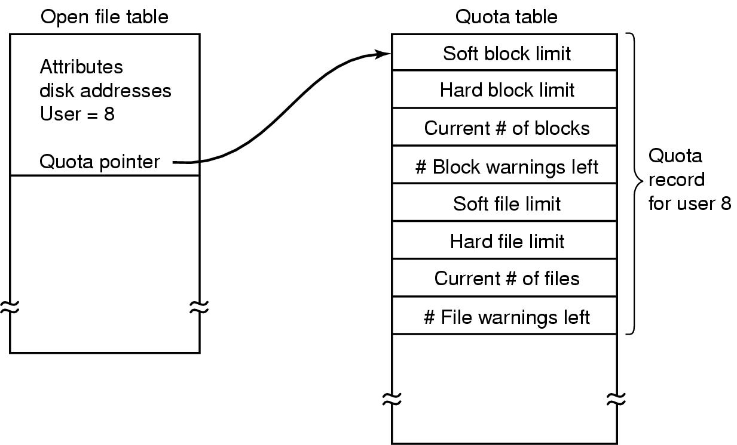
File System Management & Optimization Disk Space Management
Tanenbaum, Fig. 4-24.

Slide 79
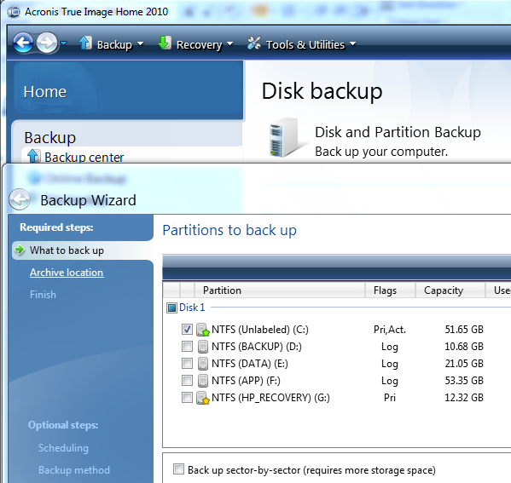
File System Management & Optimization Disk Space Management
File System Backups
Recover data from disaster or from accidentally errors
Making a backup takes a long time and occupies a large mount of space, so doing efficiently and conveniently is important
backup only specific directories
incremental dumps
backup only what was modified from the last backup
can make recovery complicated
compression
Physical dump
Start at block 0 of disk, writes all the disk blocks onto the output tap in order, and stops when it has copied the last one
There is no value in backing up unused disk blocks
Dumping bad block
Advantages: simplicity, great speed
Disadvantages: inability to skip selected directories, make incremental dumps, and restore individual files upon request

Slide 80
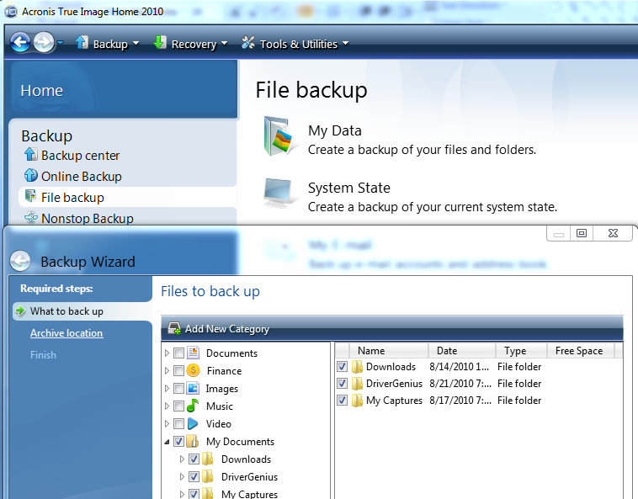
File System Management & Optimization Disk Space Management
File System Backups
Logical dump
Start at one or more specified directories and recursively dumps all files and directories found there that have changed since some given base date
Dumps all directories (even unmodified ones)

Slide 81
File System Management & Optimization Disk Space Management
File System Consistency
Problems
Many file system read blocks, modify them, and write them out later
If the system crashes before all the modified blocks have been written out, the file system can be left in an inconsistent state
If some of the blocks that have not been written out are i-node blocks, directory block, or block containing the free list
Solutions
Using a utility program checks file system consistency in booting or after a crash (ex: scandisk, fsck – fix sick file system)
There are 2 kinds of consistency: blocks and files
To check for block
The program builds two table, each one containing a counter for each block (set 0)
The counter in 1st table keep track of how many time each block is present in a file
The counter in 2nd table record how often each block is present in the free list
The program then reads all the i-nodes using a raw device, which ignores the file structure and just returns all the disk blocks starting at 0
At each block is read, its counter in first table is incremented
The program then examines the free list to find all the block that are not uses
Each occurrence of a block in the free list results in its counter in the 2nd table increased

Slide 82
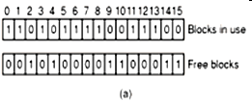

File System Management & Optimization Disk Space Management
Consistency
Tanenbaum, Fig. 4-24.
Missing block: no real harm, waste space and reduce the capacity of disk
Solution: the file system checker adds the missing block to the free list

Slide 83
File System Management & Optimization Disk Space Management
Tanenbaum, Fig. 4-24.
Missing block: no real harm, waste space and reduce the capacity of disk
Solution: the file system checker adds the missing block to the free list

Slide 84

File System Management & Optimization Disk Space Management
Duplicate in free list
Solution: rebuild the free list

Slide 85

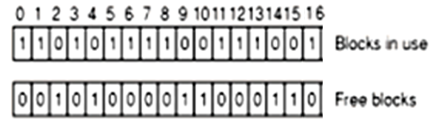
File System Management & Optimization Disk Space Management
Data block is present in two or more files → if the file is removed, both same block is free at the same time and the free is update to 2 as figure c
Solution: allocate the free block and copy one of file blocks to it

Slide 86
File System Management & Optimization Disk Space Management
Directory Consistency
Is used to check for directory and its file in consistency
It uses a table of counters per files
These counts start at 1 when a file is created and are incremented each time a link is made to the file
Traverse the directory tree
A counter is incremented when each every i-node in every directory
When the checker is all done, it has a list, indexed by i-node number, telling how many directories contain each file
It then compares these numbers with the link counts stored in the i-node themselves
Both counts will agree → consistency
The link count is higher: the file are removed, i-node will not be removed (is not serious errors and cause waste space) → fixed by setting the link count in the i-node to the correct value
The link count is lower: 2 directory entries are linked to a file, but the i-node present is only one (disaster and all blocks is release when the file is removed → the one of directories points to an unused i-node) → force the link count in i-node to the actual number of directory entries

Slide 87
File System Management & Optimization Disk Space Management
File System Performance
Access to disk is much slower than access memory because OS must seek to track and then wait for desired sector to arrive under the read head
Many file systems have been designed with various optimizations to improve performance
Cache (Block cache or buffer cache)
Is a collection of blocks that logically belong on the disk but are being kept in memory
Check all read request to see if the needed block is in the cache. If it is, accessing without disk access. Otherwise, reading into the cache, then coping to wherever it is needed
To access quickly, the hash table and the linked list is used
When a block has to be loaded into a full cache, the usual page replacement algorithms is applied (LRU is best)

Slide 88
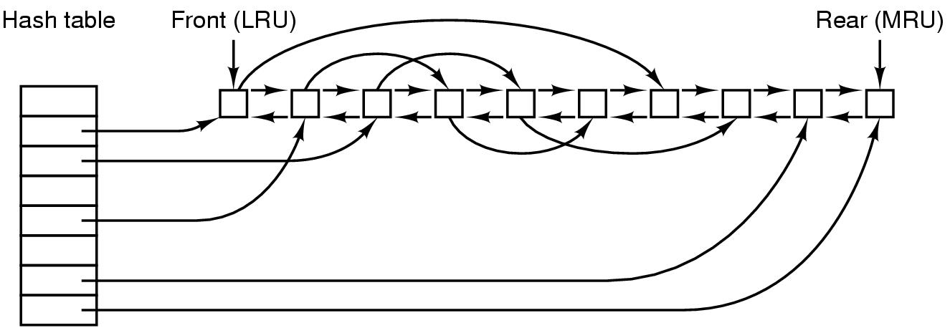
File System Management & Optimization Disk Space Management
File System Performance
Cache (Block cache or buffer cache) (cont)
Problems:
Is the block likely to be needed again soon?
Is the block essential to the consistency of the file system?
Solutions: blocks can be divided into categories such as i-node blocks, indirect block, directory blocks, full data blocks, and partially full data blocks
Blocks that will probably not be needed again soon go on the front, rather than the rear of the LRU list, so their buffers will be reused quickly. Blocks that might be needed again soon, such as a partly full block that is being written, go to the end of the list, so they will stay around for a long time
If the block is essential to the file system consistency, and it has been modified, it should be written to disk immediately (reduce crash)
Tanenbaum, Fig. 4-28.

Slide 89
File System Management & Optimization Disk Space Management
File System Performance
Block Read Ahead
Try to get blocks into the cache before they are needed to increase the hit rate
Many files are read sequentially. When the file system is asked to produce block k in a file, it does that, but when it is finished, it makes a sneaky check in the cache to see if block k + 1 is already there. If it is not, it schedules a read for block k + 1 in the hope that when it is needed, it will have already arrived in the cache
The file system can keep track of the access patterns to each open file. Initially, the file is given the sequential access mode. Whenever a seek is done, the bit is cleared. If sequential reads start happening again, the bit is set once again

Slide 90
File System Management & Optimization Disk Space Management
File System Performance
Block Read Ahead
Try to get blocks into the cache before they are needed to increase the hit rate
Many files are read sequentially. When the file system is asked to produce block k in a file, it does that, but when it is finished, it makes a sneaky check in the cache to see if block k + 1 is already there. If it is not, it schedules a read for block k + 1 in the hope that when it is needed, it will have already arrived in the cache
The file system can keep track of the access patterns to each open file. Initially, the file is given the sequential access mode. Whenever a seek is done, the bit is cleared. If sequential reads start happening again, the bit is set once again

Slide 91
File System Management & Optimization Disk Space Management
File System Performance
Reducing Disk Arm Motion
Put blocks that are likely to be accessed in sequence close to each other, preferably in the same cylinder
Keep track of disk storage not in blocks, but in groups of consecutive blocks
When allocating blocks, the system attempts to place consecutive blocks in a file in the same cylinder (rotational positioning)
Put the i-nodes in the middle of the disk, rather than at the start, thus reducing the average seek between the i-node and the first block by a factor of two
Divide the disk into cylinder groups, each with its own i-node, blocks, and free list. When creating a new file, any i-node can be chose, but an attempt is made to find a block in the same cylinder group as the i-node. If none is available, then a block in a near by cylinder group is used

Slide 92
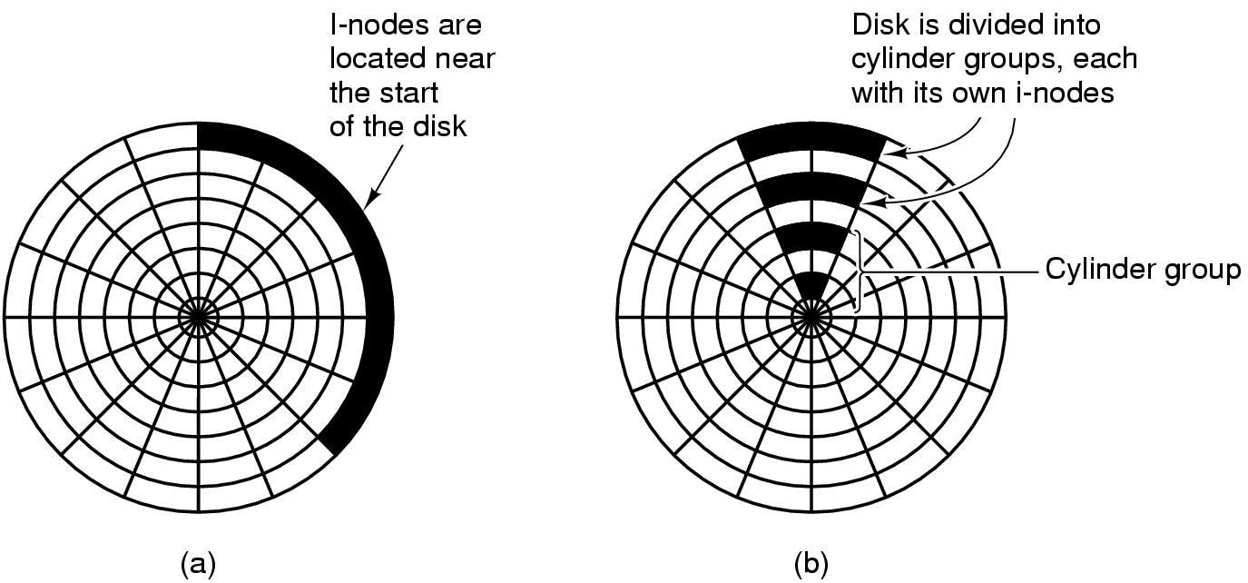
File System Management & Optimization Disk Space Management
Tanenbaum, Fig. 4-29.

Slide 93
File System Management & Optimization Disk Space Management
File System Performance
Defragmenting Disks
Disks become badly fragmented with files and holes all over the place → giving poor performance when new file is created
→ moving files around o make them contiguous and to put all of the free space in one or more large contiguous regions on the disk

Slide 94
Example File Systems CD-ROM File Systems
Simple because they were designed for write once media
They have no provision for keeping tracking of free blocks
Do not have concentric cylinders. Instead have a single continuous spiral containing the bits in a linear sequence. The bits along the spiral are divided into logical blocks
CD-R
is possible to add files after the initial burning, but these are simply appended to the end of the CD-R
All the free space is in one contiguous chunk at the end of the CD
Files are never removed (although directory can be updated to hide existing files)
ISO 9960
An International Standard in 1998
Make every CD-ROM readable on every computer, independent of the byte ordering used and independent of the OS used

Slide 95
Example File Systems CD-ROM File Systems
Rock Ridge Extensions
In the UNIX community began working on an extension to make it possible to represent UNIX file systems on a CD-ROM
Use the System use field in order to make Rock Ridge CD-ROMs readable on any computer
Any system not aware of the Rock Ridge extensions just ignores them and sees a normal CD-ROM
Rock Ridge extension fields:
PX - POSIX attributes.
PN - Major and minor device numbers.
SL - Symbolic link.
NM - Alternative name.
CL - Child location.
PL - Parent location.
RE - Relocation.
TF - Time stamps.

Slide 96
Example File Systems CD-ROM File Systems
Joliet Extensions
Is invented by Microsoft
Were designed to allow Windows file systems to be copied to CD-ROM and then restored, in precisely the same way that Rock Ridge was designed for UNIX
Joliet extension fields
Long file names.
Unicode character set.
Directory nesting deeper than eight levels.
Directory names with extensions

Slide 97
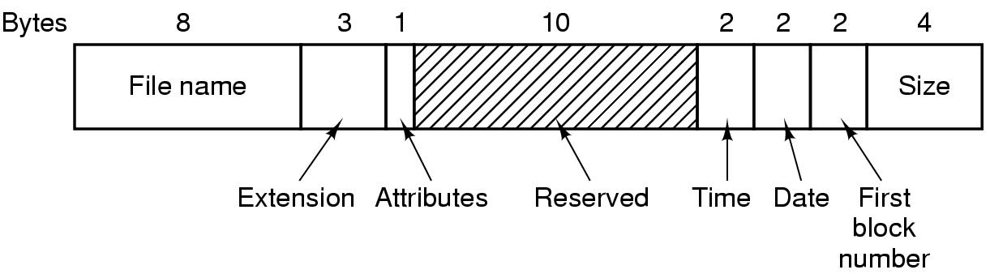
Example File Systems MS-DOS File System
To read a file, MS-DOS must first make an open system call to specifies a path that is looked up component to component until the final directory is located and read into memory. It is then searched for the file to be opened
Use a fixed-size 32 byte directory entry
File names (8 + 3) characters
Stores the file size as a 32 bit number (can be large as 2GB)
Keeps track of file blocks via a FAT in main memory
Tanenbaum, Fig. 4-31.

Slide 98
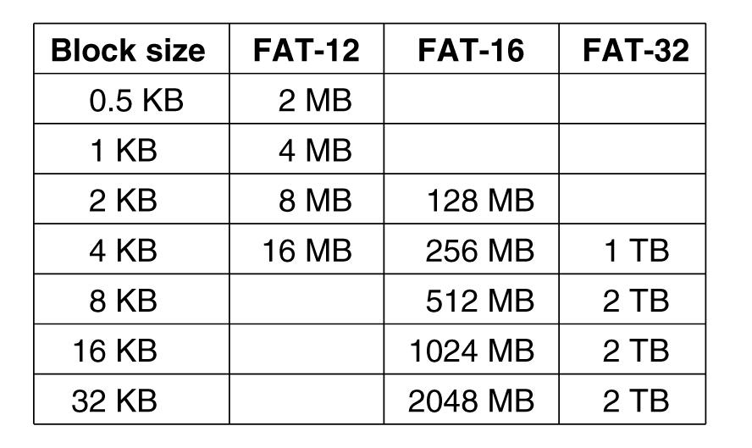
Example File Systems MS-DOS File System
Tanenbaum, Fig. 4-32.

Slide 99
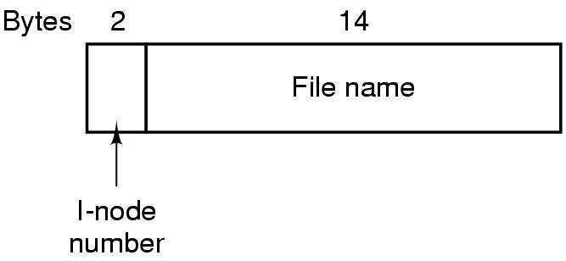
Example File Systems UNIX V7 File System
Form of a tree starting at the root directory, with the addition of links, forming a directed acyclic graph
File names are up to 14 characters and can contain any ASCII character except and NULL
A UNIX directory entry contains one entry for each file in that directory including file name (14 bytes) and the number of i-node (2 bytes).
Each entry is extremely simple because it uses the i-node that can contain some attributes
Tanenbaum, Fig. 4-33.

Slide 100
Example File Systems UNIX V7 File System
Tanenbaum, Fig. 4-34.

Slide 101
Summary
Operating System Concepts
Files
Directories
File System Implementation
File System Management and Optimization
Example File Systems
Q&A

Slide 102
Next Lecture
I/O Hardware
I/O Software
Principles
Layers
Disk management
Disk Arm Scheduling Algorithms
Error Handling
Stable Storage

